Slide 1
Analytical Geometry and Linear Algebra 1
Introduction
Vector + Operations of vectors
Basis
Subspace

Slide 2
Цели пары
Тут много теор слов, нужно сделать упор для чего мы это делаем (можно порисовать картинку, как я делал с Симеоном (из чего состоит линал, ангем и все это)
Сделать упор на то, как готовиться, почему я показываю геогебру итп
Показать что в задачах на паре есть множество решений (в последних)

Slide 3

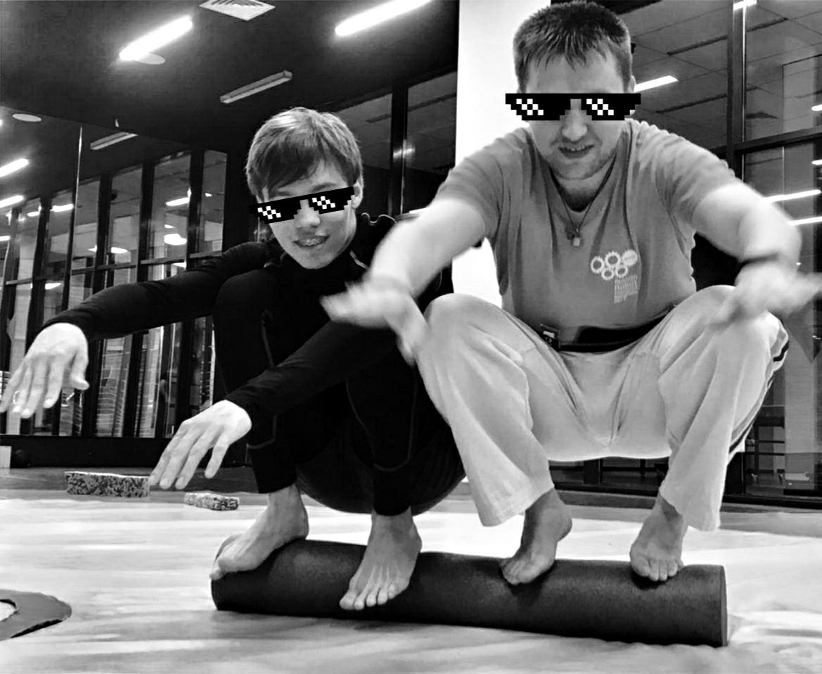

About me (1)
Bachelor in BMSTU
“CAD developer” track
ДИЧь / RAGE (Древнерусские Игры и чай) club leader
Channel
Finished PhD in Inno
Research Fellow

Slide 4
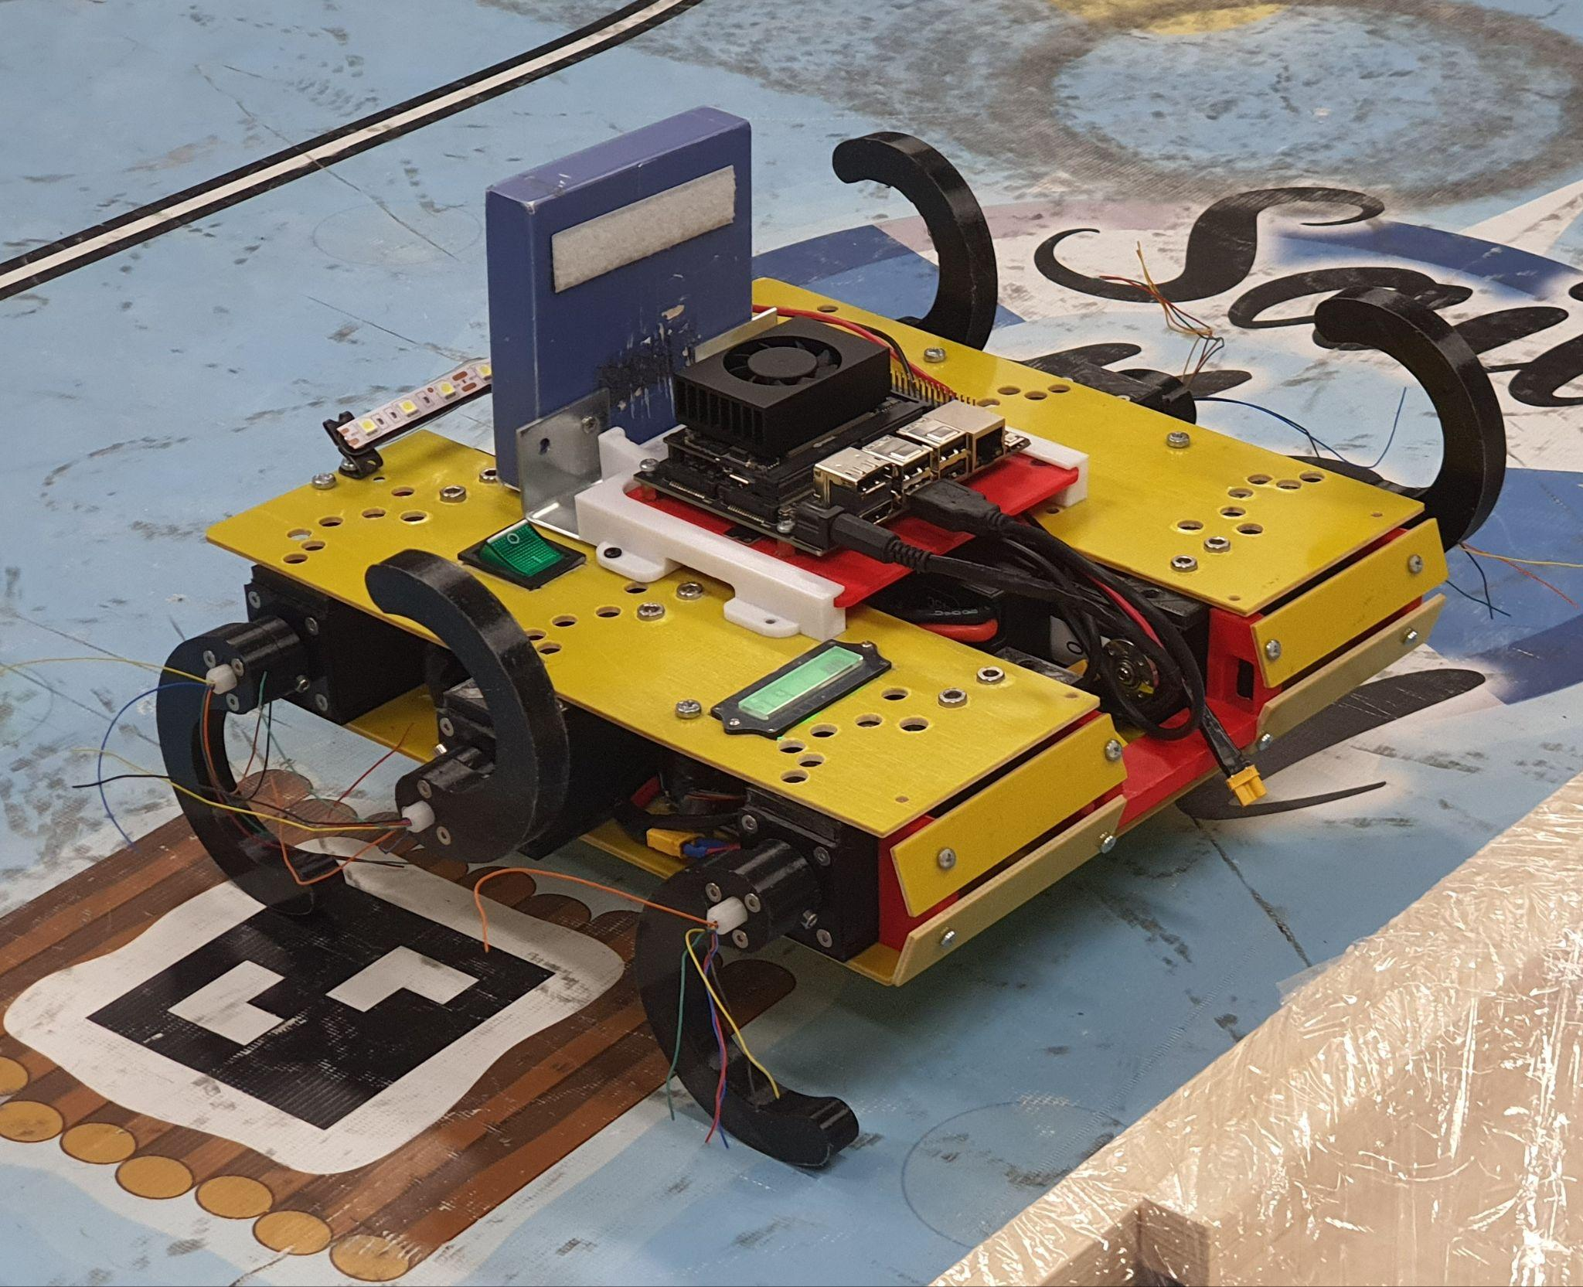
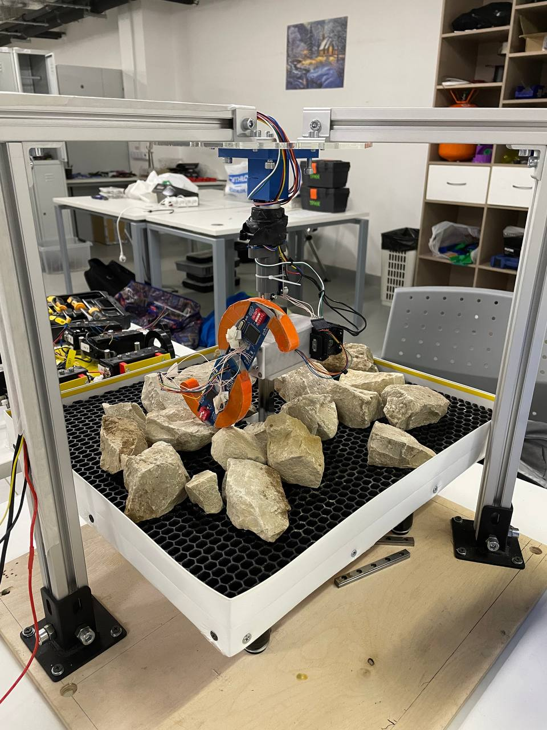
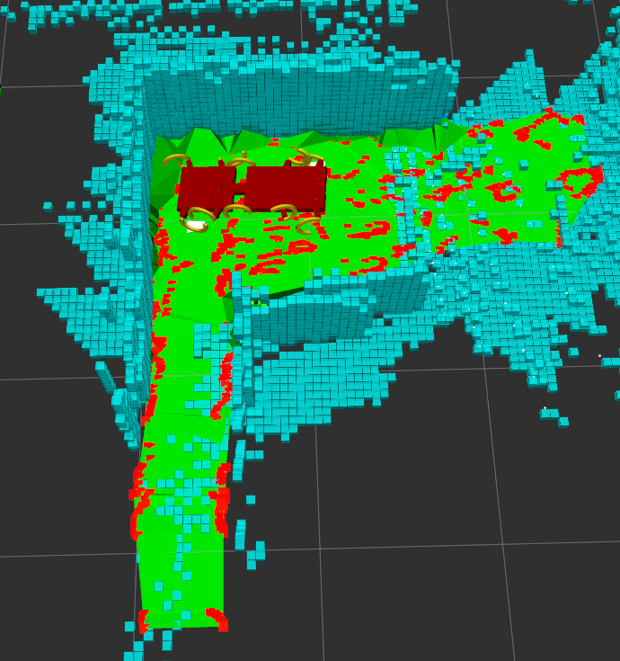
About me (2)
Research interest - Multilegged biomimetic robots
Dissertation title: Perception method development for a mobile multilegged robot in a cave environment

Slide 5
Where did I use
Linear Algebra

Slide 6
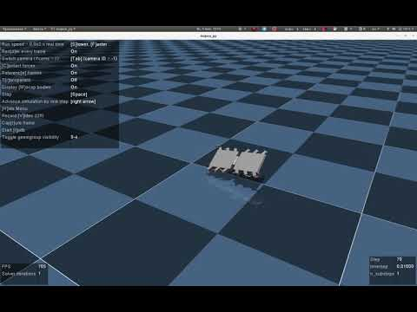
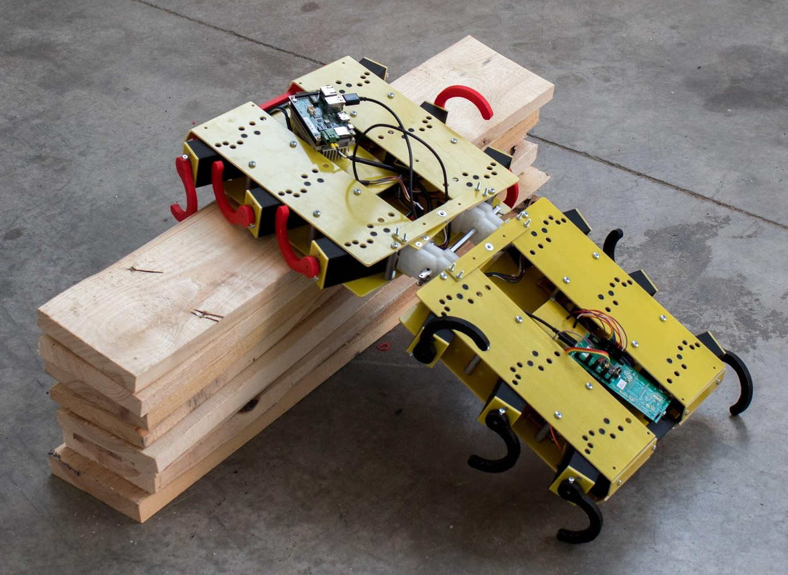
Where did I use linear algebra (1): Research
Multilegged robot StriRus

Slide 7
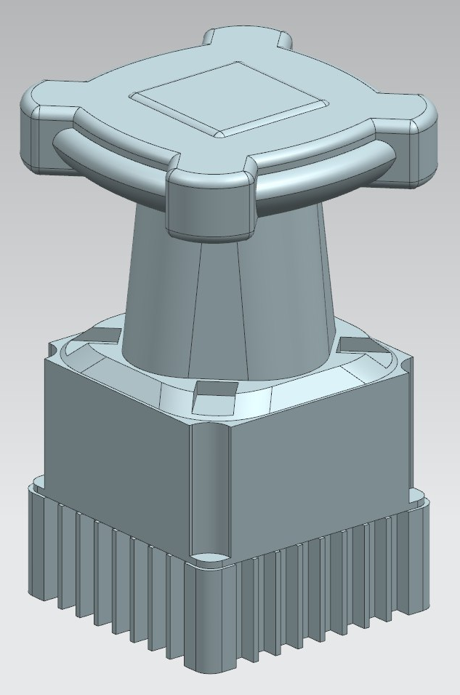
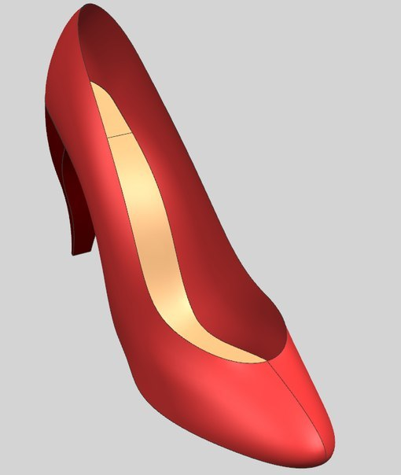
Where did I use linear algebra (2): CAD
Solid Modeling
Surface Modeling

Slide 8
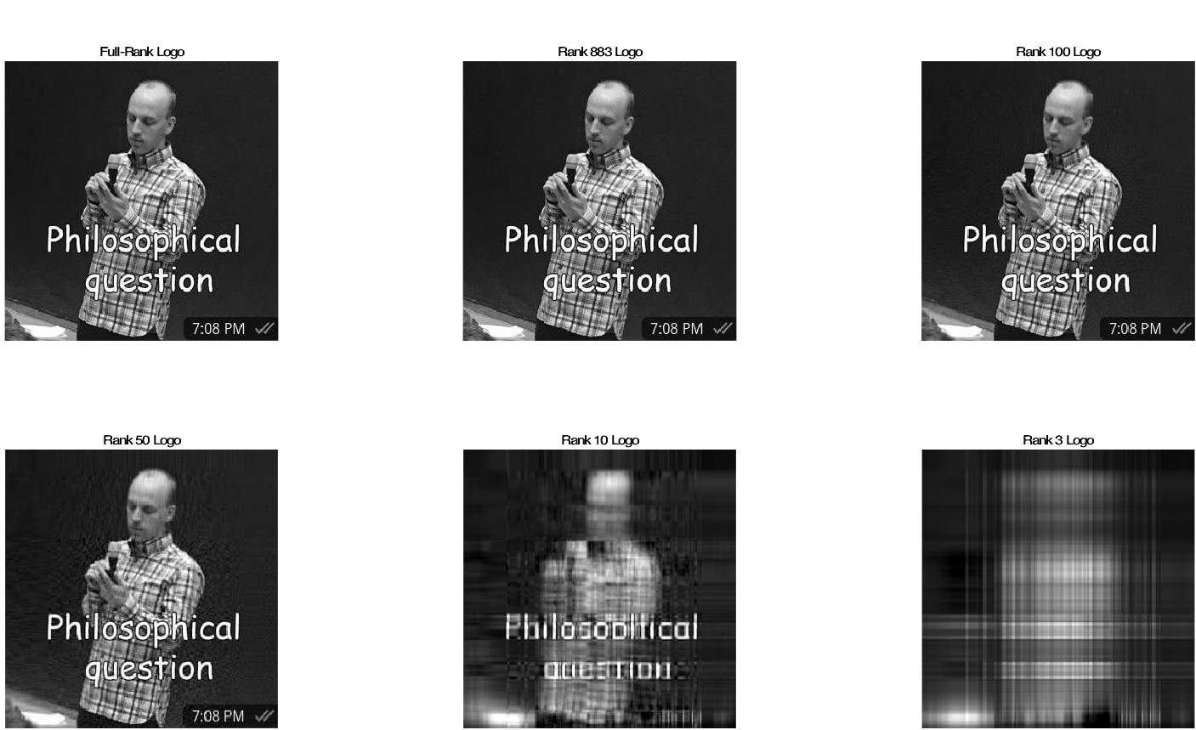
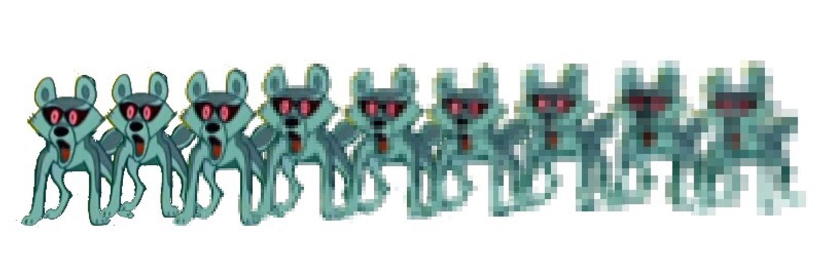
Image compression
Task: We want to compress our image for reducing the size
Solution: We can represent our picture as a matrix.
Next step is using SVD for reducing matrix rank.
More details in matlab code (pdf)

Slide 9
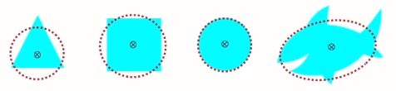
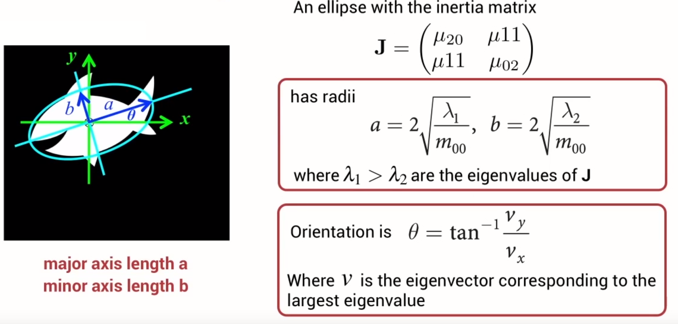
Computer vision
Task: we want to know the orientation of the object
Needed terms: Centroid, Image moments
Solution: use equivalent ellipse method. We consider an ellipse, witch:
centred at the object’s centroid
same moments of inertia about centroid.
Afterwards, we find an ellipse using eigenvalues and eigenvectors
Equivalent ellipse for several objects
Feature extraction masterclass video

Slide 10
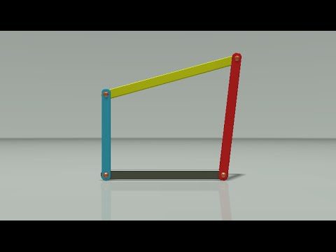
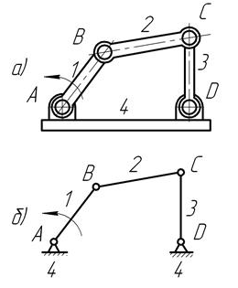
Where did I use linear algebra (3): Mechanics

Slide 11
Short summary
I used to use the course knowledge in my research career
It’s not a useless course and I’ll try to show it (practical cases) (not only from robotics)
I will give you an intuition of some basics

Slide 12
Agreements among the group (for now)

Slide 13
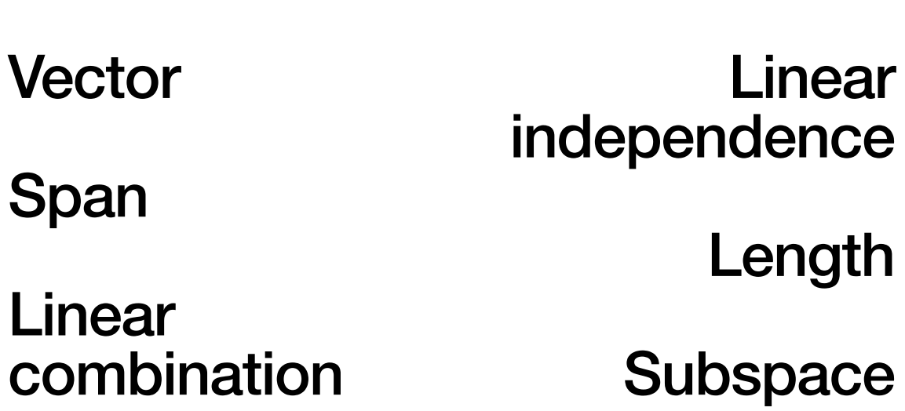
Pretest

Slide 14
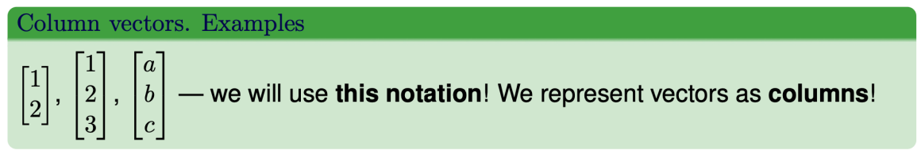
Vector

Slide 15
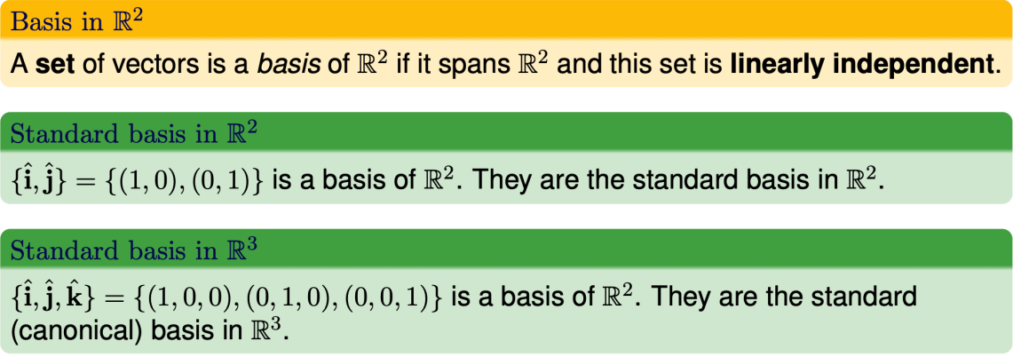
Basis

Slide 16
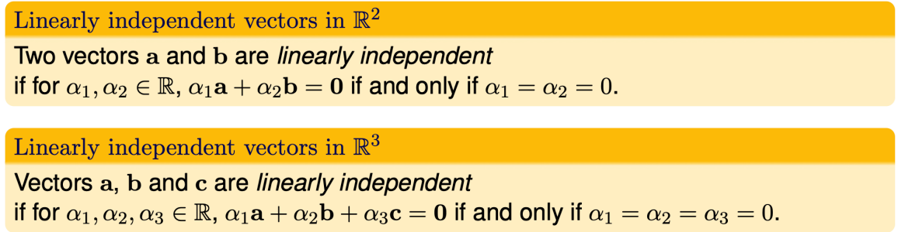
Linear Independence

Slide 17
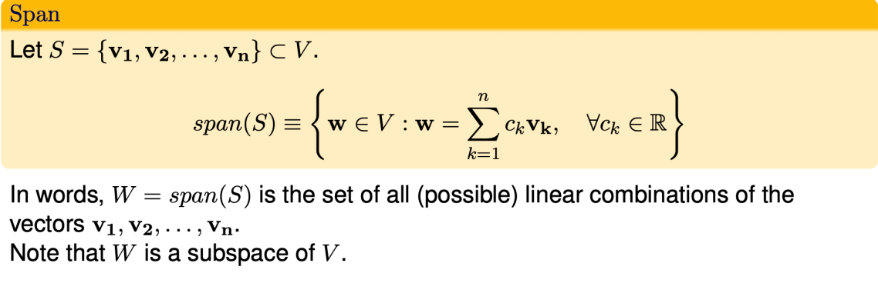
Span

Slide 18
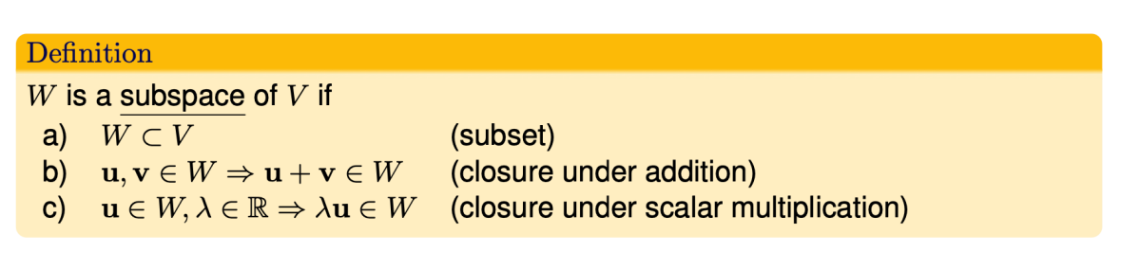
Subspace

Slide 19
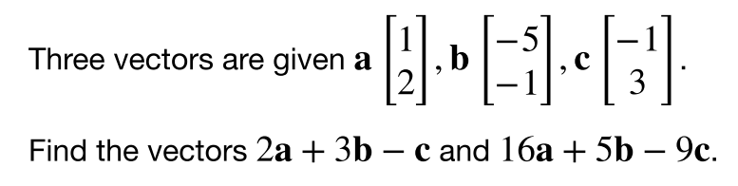
Task 1

Slide 20
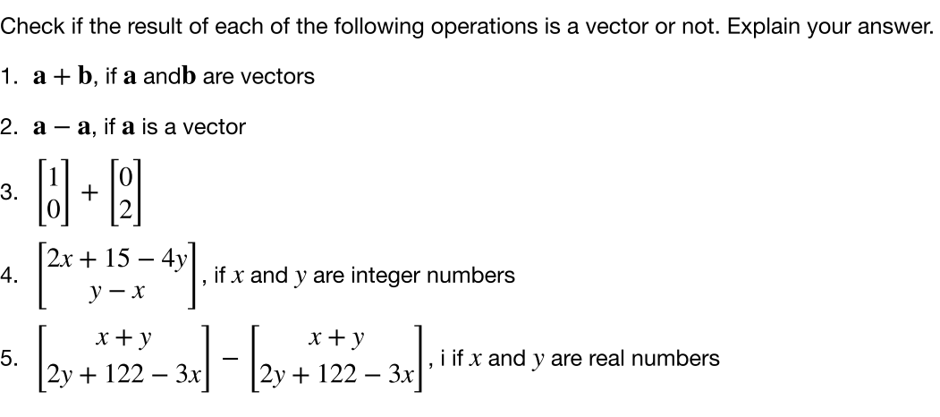
Task 2

Slide 21
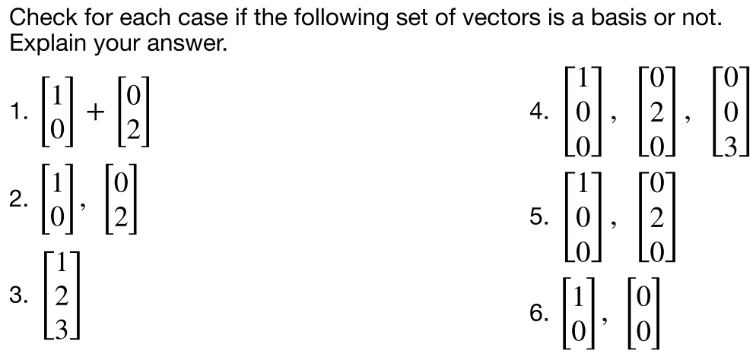
Task 3

Slide 22
Task 3: answers
—
—
—
—

Slide 23
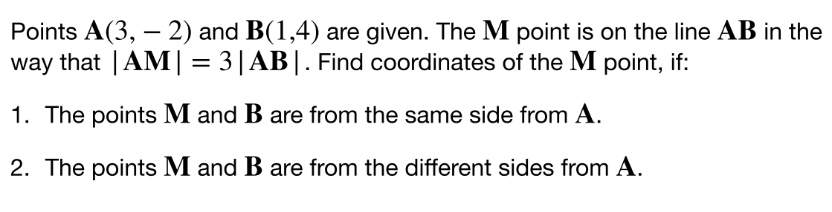
Task 4

Slide 24
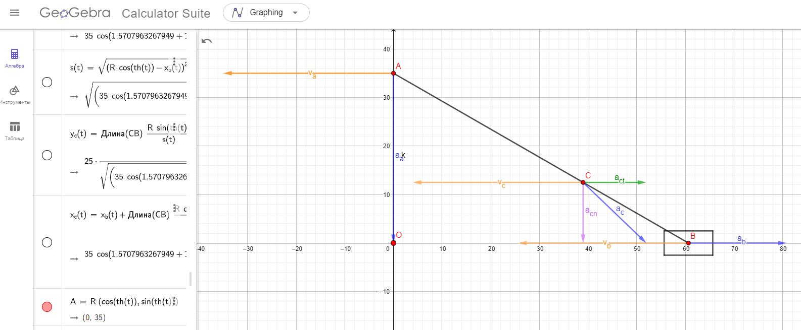
Possible tool for simulation
Geogebra

Slide 25
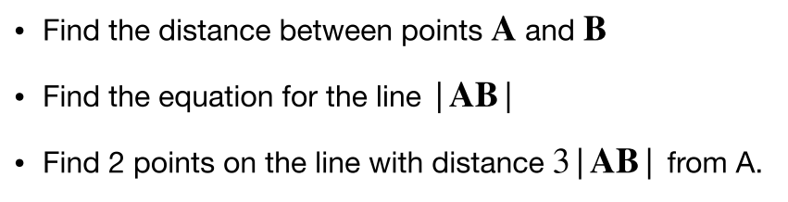
Task 4 (1 of possible solutions)

Slide 26
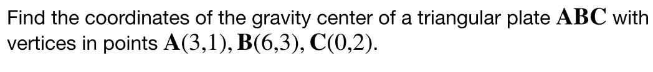
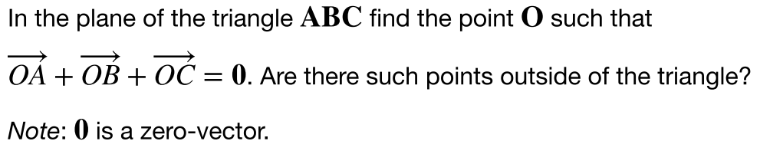
Task 5 + 6

Slide 27
Center of gravity VS Center of mass
For classical mechanics - it’s the same. More info here

Slide 28
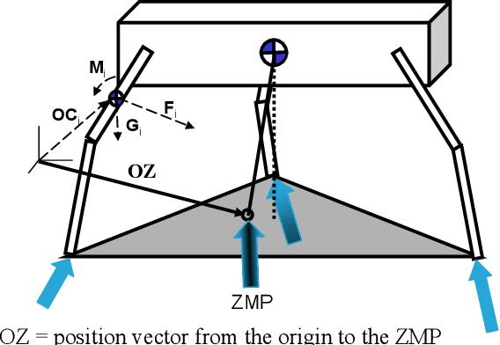
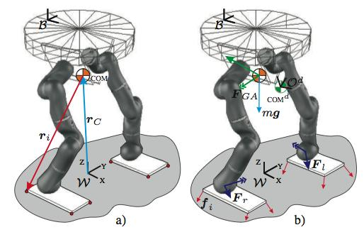
Where a center of mass can be used?

Slide 29
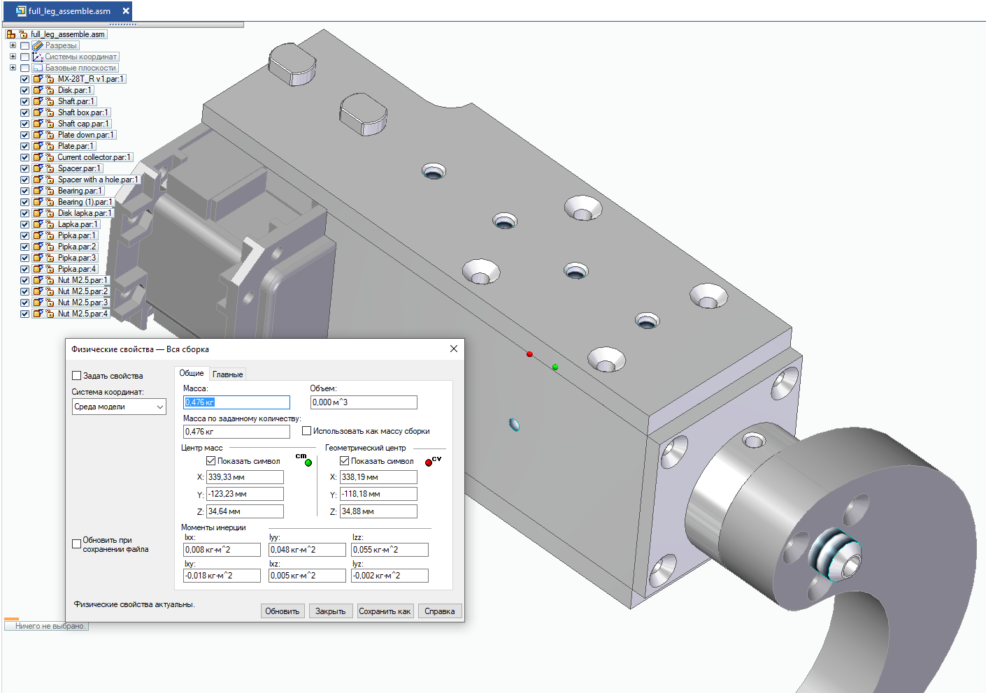
How to find the center of mass in real life

Slide 30
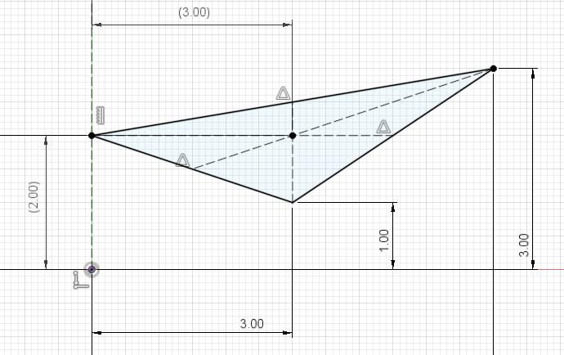
Task 5 + 6 sol

Slide 31
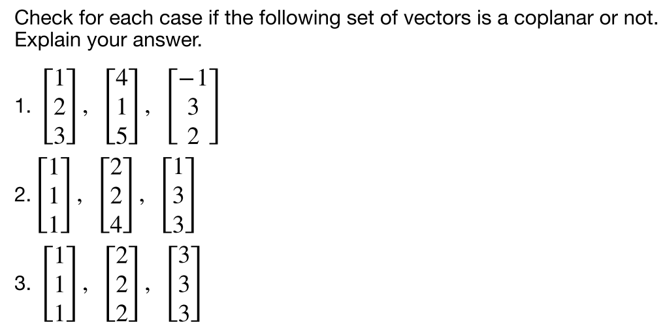
Task 7

Slide 32
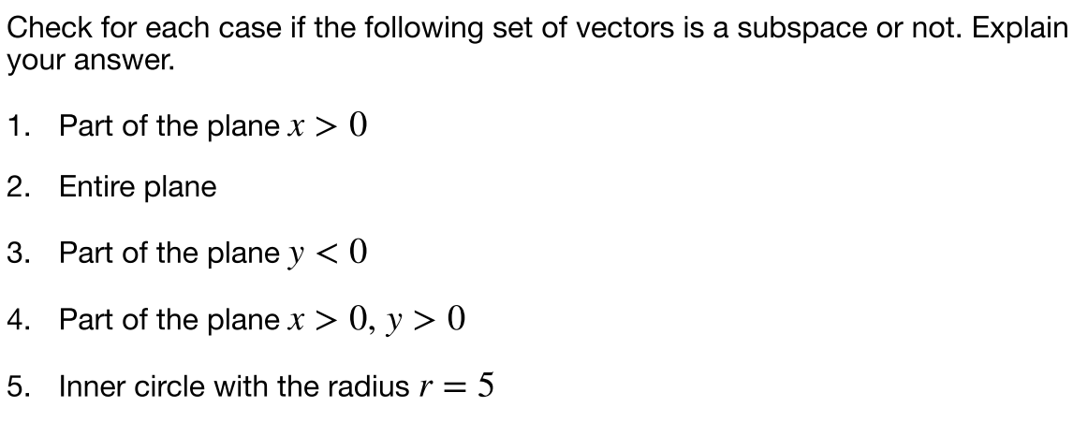
Task 8

Slide 33
Subspace

Slide 34
Extra material (3bluebrown)
Vectors
Basis, linear independence

Slide 35
Best extra extra materials
1) RUS - Матпрофи
2) ENG - OnlineMSchool - not only explanation, but also online calculators
3) ENG Videos - 3Blue1Brown
4) ENG Lectures - Gilbert Strang - AGLA2 based on the course

Slide 36
Deserve “A” grade!
– Oleg Bulichev

